Slide 1
Decision Trees & Random Forests
The Data Bootcamp |
April 14, 2018

Slide 2
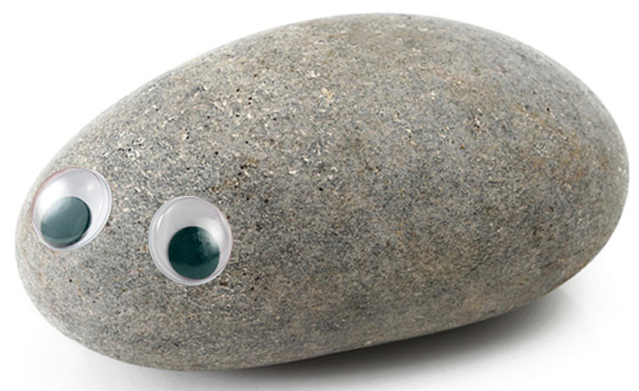

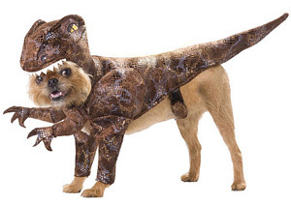

Decision Trees
Decision Trees encode a series of True/False questions.
Pet Picker:
Do you travel?
Yes
No
Are you gone more than 1 week?
Do you like to dress up your pets?
Yes
No
Yes
No

Slide 3
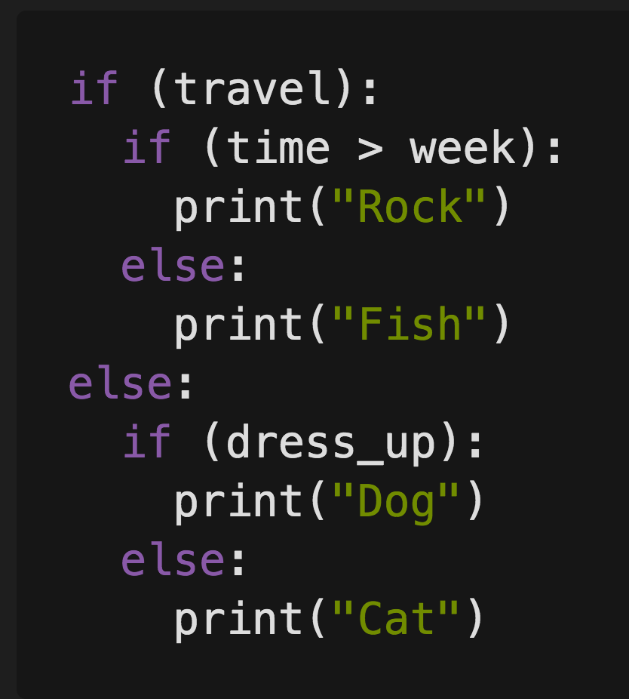
Decision Trees
These True/False questions can be represented with a series of If/Else Statements
Do You Travel?
Yes Travel:
Are you gone for more than 1 week?
Yes: Pet Rock
No: Pet Fish
No Travel:
Do You like to dress up your pet?
Yes Dress Up: Pet Dog
No Dress Up: Pet Cat

Slide 4
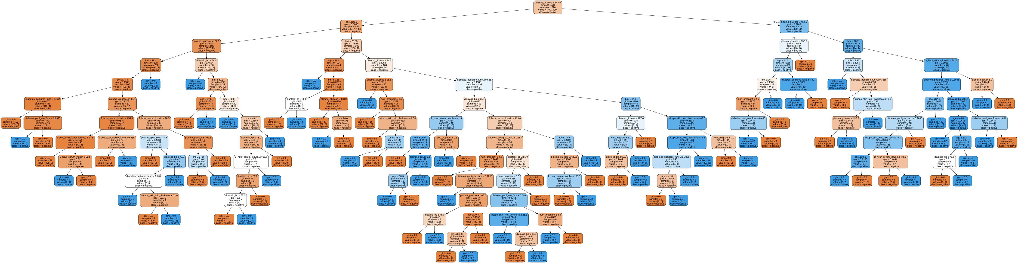
Decision Tree Complexity
Decision Trees can become very complex and may not generalize well

Slide 5
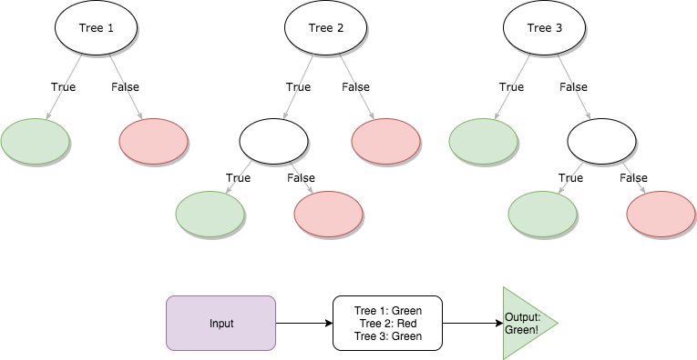
Random Forests
Instead of a single, complex tree like in the previous slide, a random forest algorithm will sample the data and build many smaller, simpler decisions trees (i.e. A forest of trees).
Each of these trees are much simpler because they are built from a subset of the data.
Each simple tree is considered a “weak classifier”, but when you combine them, they form a “strong classifier”

Slide 6
Questions / Discussion
Notes:
It’s important to keep in mind why you joined this class. Let’s talk about your goals.

